Slide 1
Simulating the 3D atmospheres
Development of three dimensional simulations – relevant for all planets:
Molecules vary strongly with position and height
Terrestrial planets, ground coverage and clouds dominate the reflectivity
Gas giants, different types of cloud important (CH₄, NH₃, H₂O)
Inclusion of 3D clouds as they of critical importance in atmospheres:
Energy balance
Composition (photochemistry, transport of H₂O)
Detectability of molecular species

Slide 2

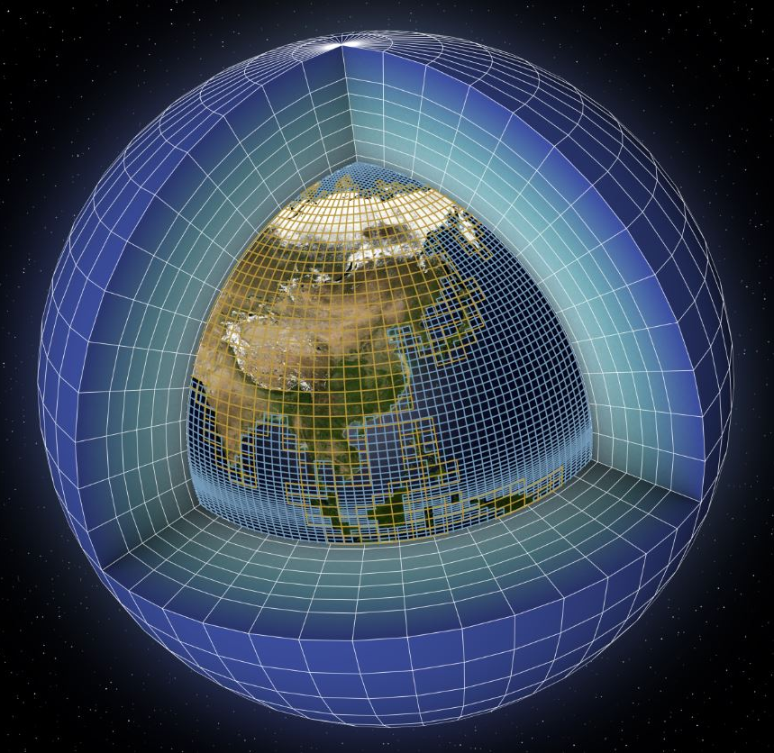
Global Climate Models
Global circulations models allow the investigation of climate responses to changing conditions:
Radiation-temperature,
ocean-atmosphere interactions,
clouds,
mass transport,
changes in sea/land ice,
ocean currents …
For exoplanets:
Stellar types/temperature,
rotation rates,
eccentricity,
Earlier states of the Earth

Slide 3

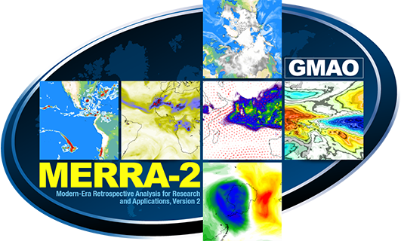
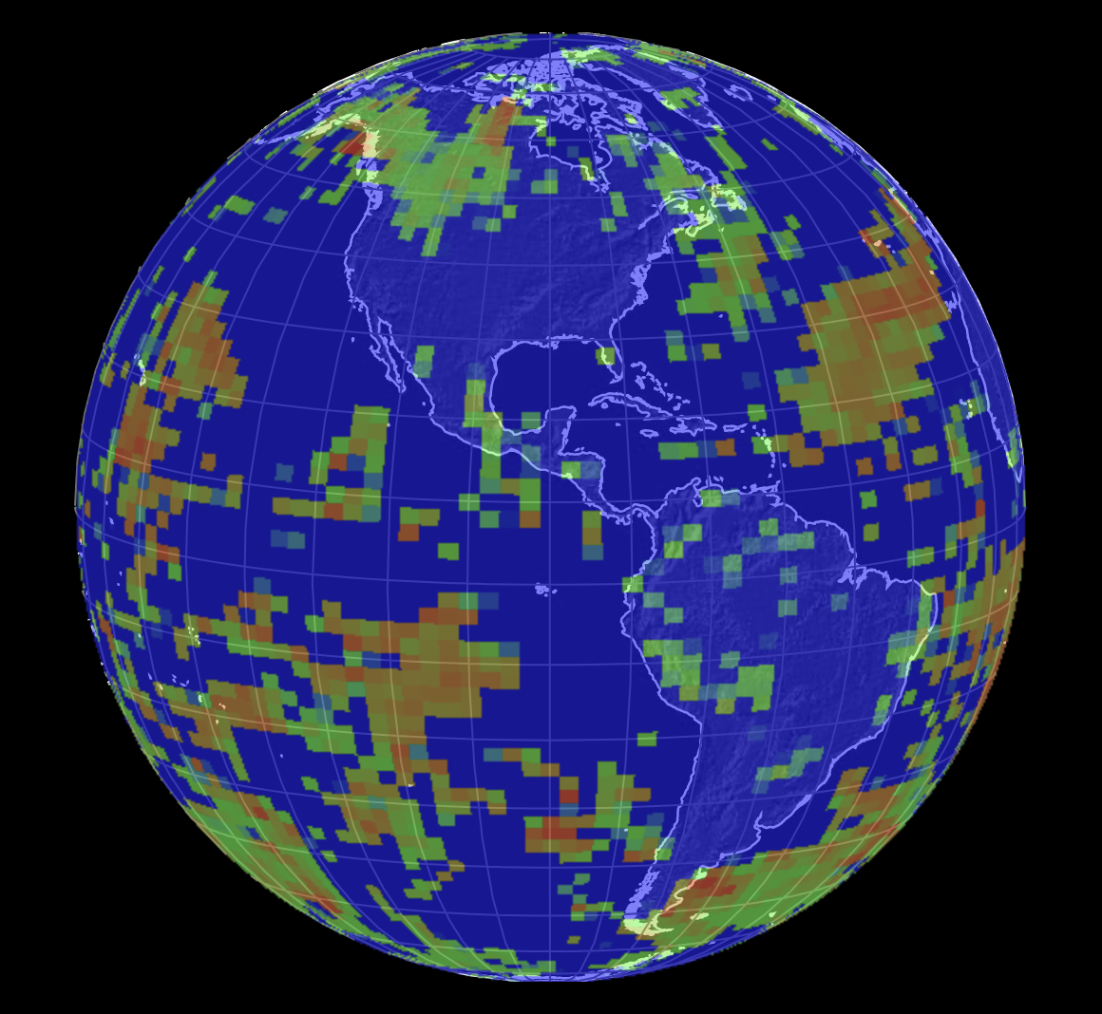
Science case: full-disk simulations of Earth
Monthly averaged surface types
H₂O, O₃, pressure & temperature (144x92x72 cells)
Liquid & ice cloud abundance for each cell
Addition of aerosols
PSG Simulations
DSCOVR:EPIC

Slide 4
Spatial verifications: DSCOVR - EPIC

Slide 5
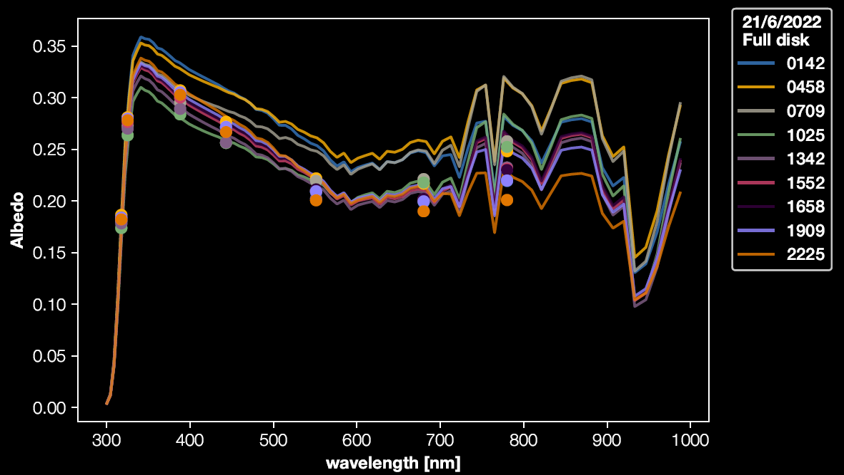
Intensity verifications: fluxes from DSCOVR:EPIC
PSG Simulations
DSCOVR:EPIC

Slide 6
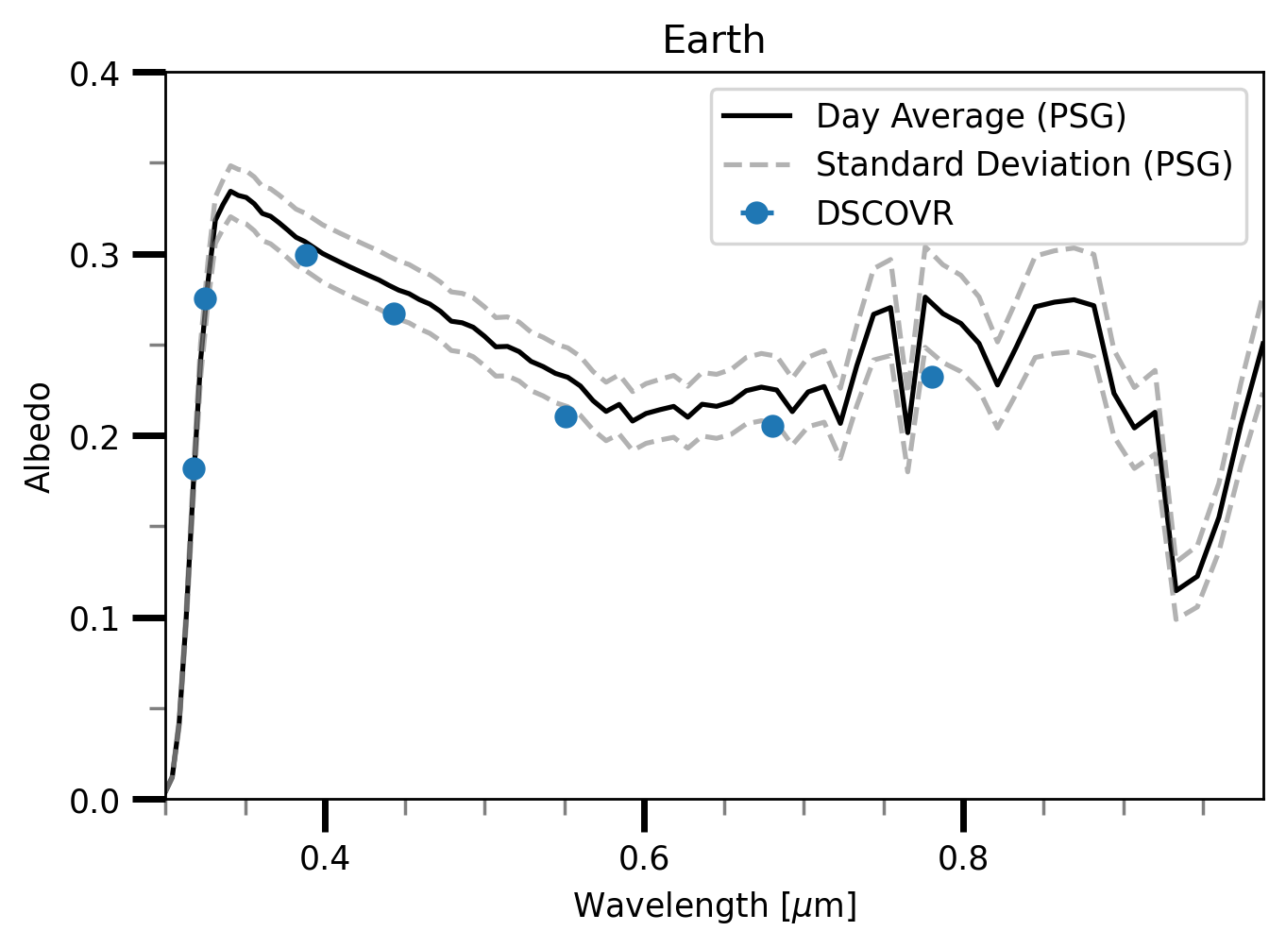
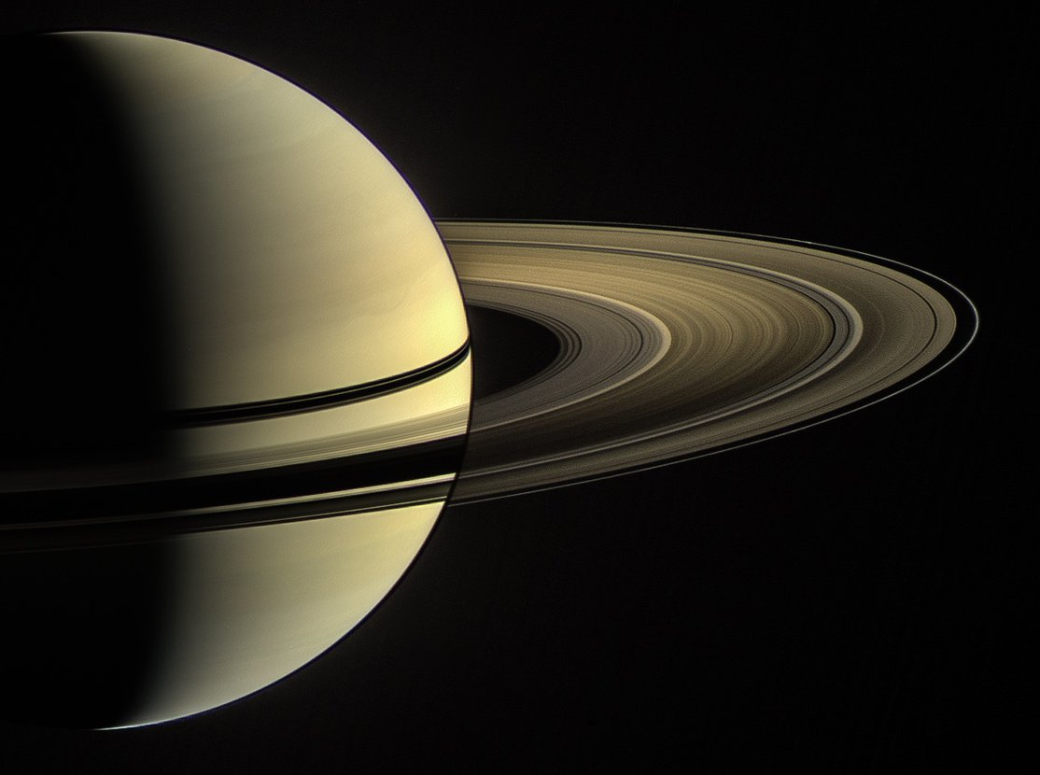
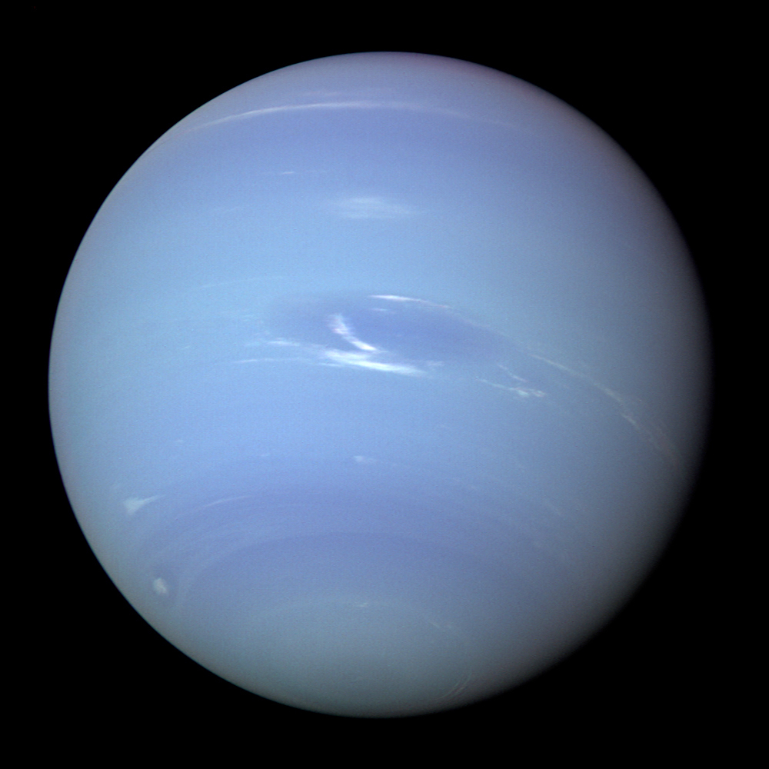
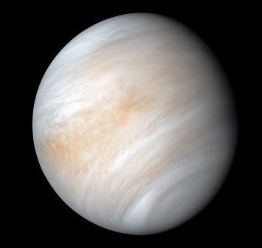
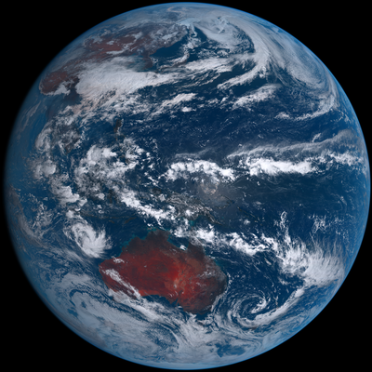
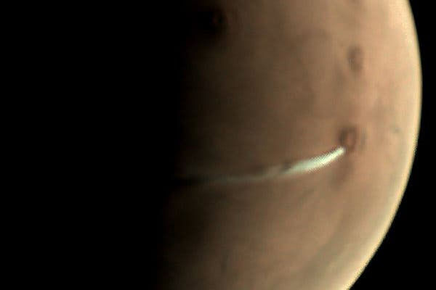
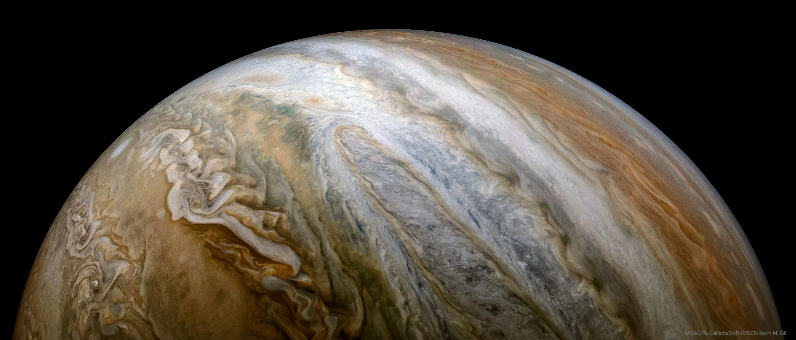
Earth Reflected Light Albedo Spectrum
To be included in my upcoming paper!
Payne et al., PSJ

Slide 7
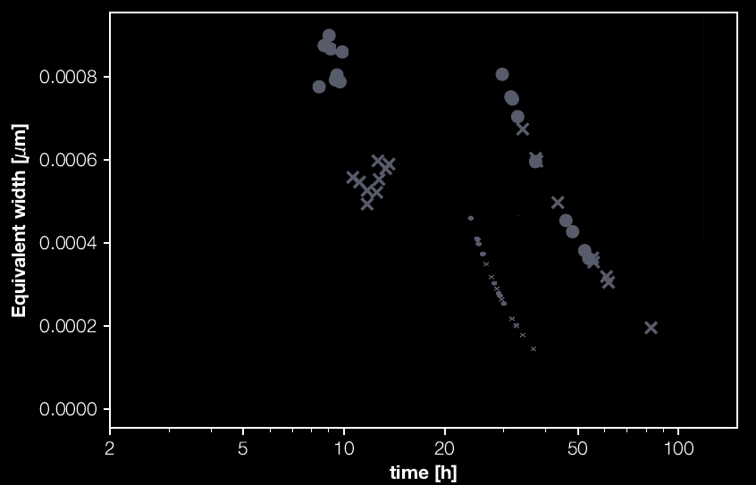
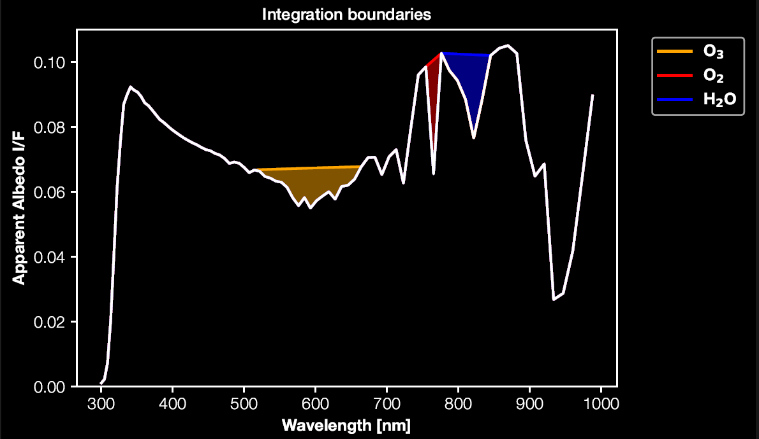
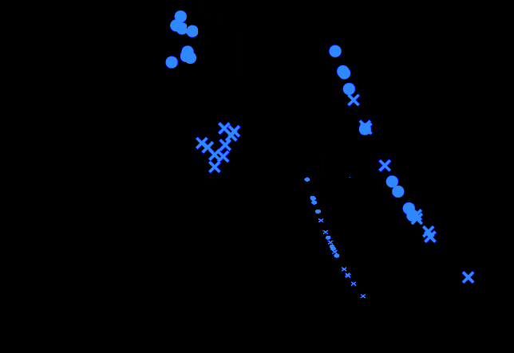
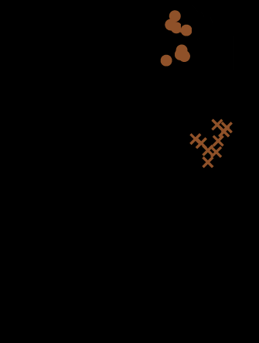
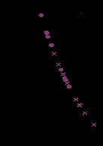
Observational sensitivities
O₃ with HWO
(Cloudy)
Integrate spectral features
Determine the time required to constrain atmospheric features
H₂O with HabEX
O₃ with HWO
(Clear)
O₂ with HWO

